Slide 1
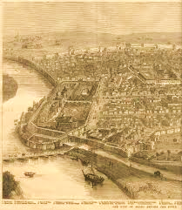
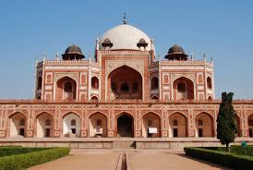
BA Programme
History
General Elective
(GE)
Semester VI
Delhi
Through the
Ages

Slide 2
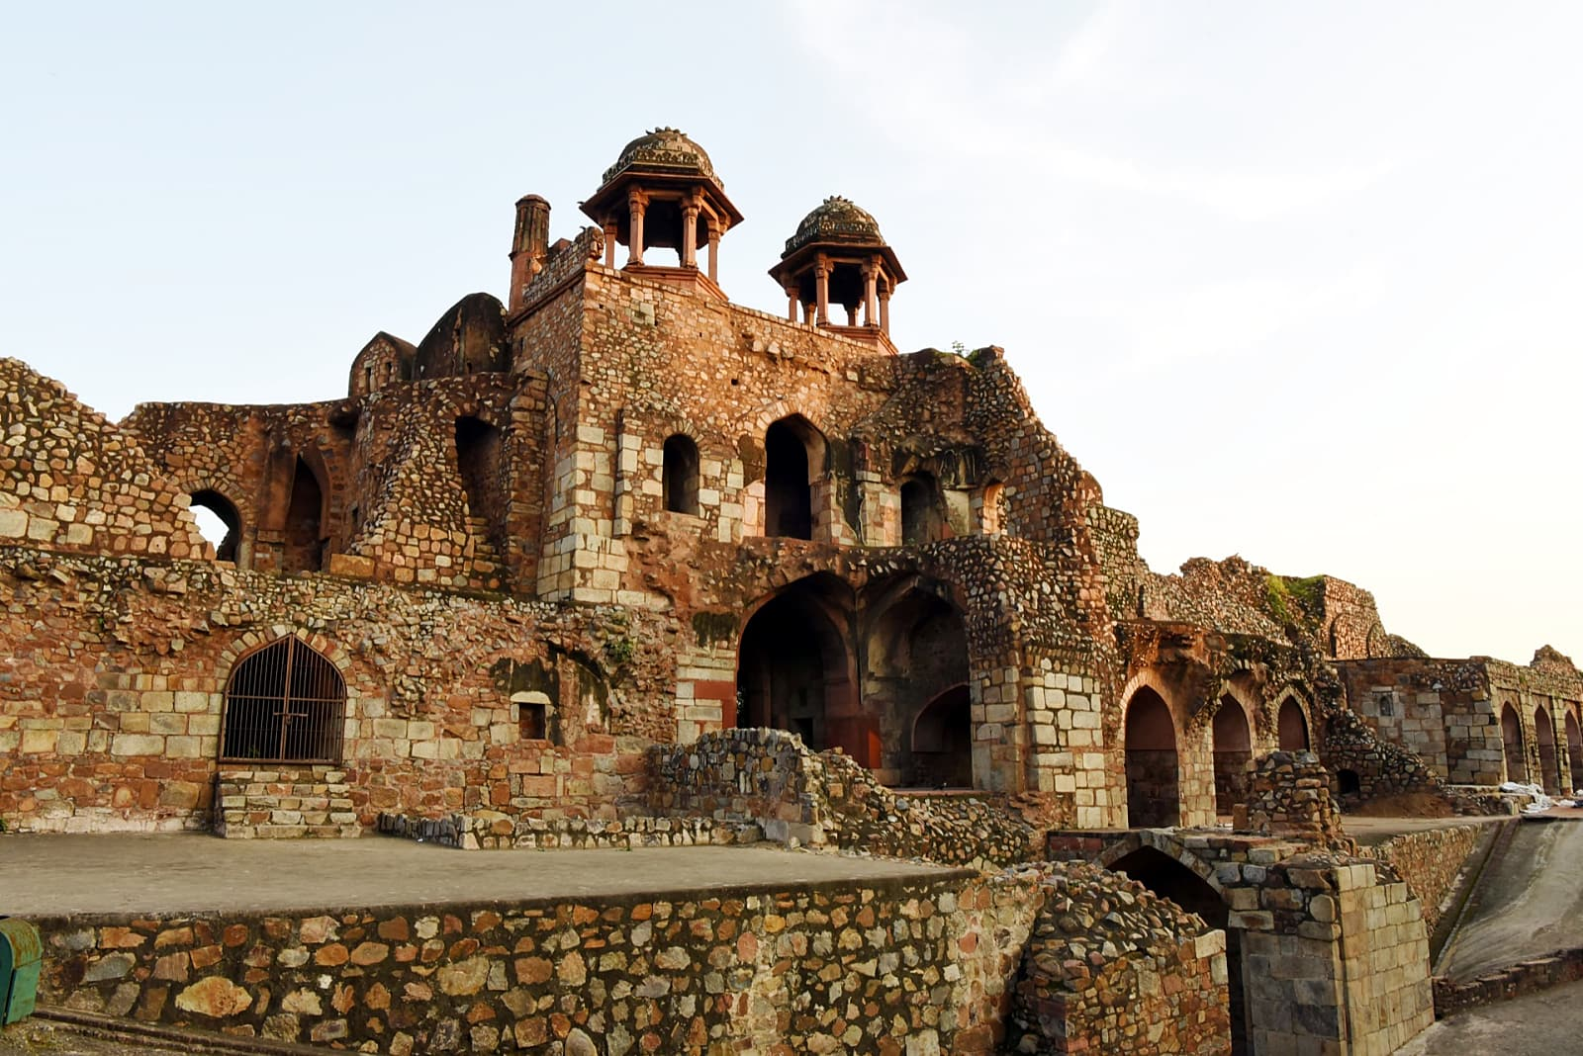
Course Objectives:
To introduce students to a history of Delhi from earliest times to the 20th century
To situate the Delhi plain in the context of larger historical processes and examine the emergence of the city
To trace the growth of the city into one of the largest in the world through immigration, state patronage and
cultural efflorescence
To examine the physical and social transformation of Delhi from colonial to contemporary times

Slide 3
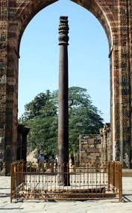
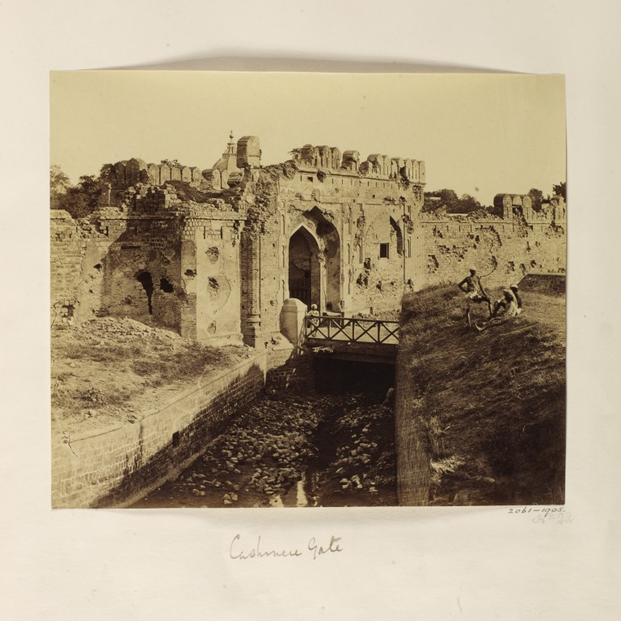
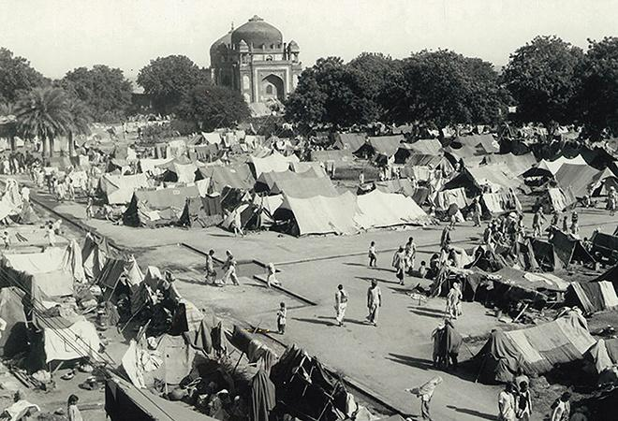
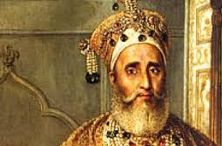
The syllabus can be accessed at:
http://du.ac.in/du/uploads/Syllabus2016/20092016_Revi_BA_P.pdf
Important themes include:
The lives of Delhi’s monuments
Delhi’s
Prehistoric
Past
The Revolt
Of
1857
The Pillar Inscriptions of Delhi
The Revolt
of 1857
in
Delhi
The Pillar inscriptions of Delhi
Partition
Partition

Slide 4
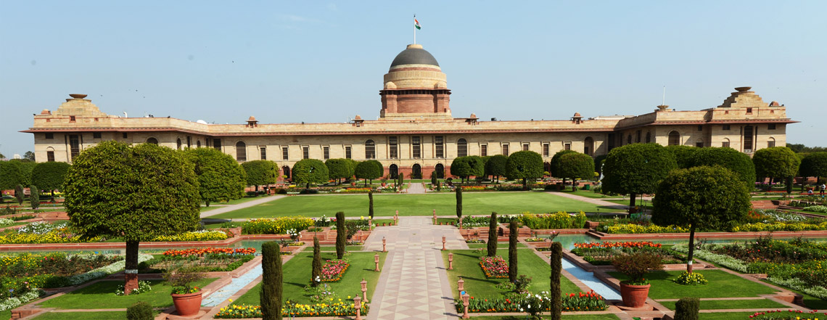
Learning Outcomes –
Upon completion of the course a student will be able to:
Analyse different kinds of sources – archeological, architectural and a variety of textual materials
Use these materials and correlate their sometimes discordant information
Consider myth and legend in the making of historical narratives
Analyse processes of urbanization and state formation
Explain the historical roots of the problems of sustainable urbanization with regard to Delhi

